Slide 1
Placement management system

Slide 2

CAMPUS RECRUIT !!!!!

Slide 3
INDEX
Introduction​
Tools Used
Purpose
Main Module
Functional Requirements
Student Features
Administrator Features
​Non-Functional Requirements
Use Case Diagram
Class Diagram
E-R Diagram
Expected Outcome
​​

Slide 4
Introduction
The Placement Management System is a web-based application designed to streamline the process of managing placements for our university. The system aims to provide a centralized platform for students and administrators to facilitate efficient communication and coordination.

Slide 5
TOOLS USED
The Placement Management System will be built as a web-based application using the following technologies:
Front-end: HTML, CSS, JavaScript,
Frame-work: ASP.NET
Back-end: C#, JQuery
Database: SQL server

Slide 6
PURPOSE
Maintain individual Student record.
Maintain Section wise Student details.
Evaluating Student performance.
Generating random ID for each student which is unique.
Making only eligible Students to take the test.
Allow online registrations.

Slide 7
MAIN MODULE
ADMIN MODULE
Here Admin should manage user's and employee’s account in various way if any of user or employee found that abuse of site than admin can ban him. Admin also can maintain master level database details and can fill entry in the various master table fields like city, state, country, products, categories etc.

Slide 8
CONTINUE…….
STUDENT MODULE
Student is registered by the this site. A student can apply job for company and eligible students give a Exam which is held by company.

Slide 9
FUNCTIONAL REQUIREMENTS
User Registration
Students should be able to register and create their respective accounts.
The system should validate and store user information, including personal details and contact information.

Slide 10
CONTINUE…….
User Authentication
Users should be able to log in to the system using their registered credentials.
The system should authenticate user credentials and grant access based on user roles.
The system should support different user roles such as student and administrator.
Each role should have specific permissions and access rights within the system.

Slide 11
STUDENT FEATURES
The system should provide the following functionalities for students:
Profile Management
Students should be able to create and manage their profiles.
Profile information should include personal details, educational qualifications, skills, and other relevant information.
Student should be able to view all the posted placement.
Student should be allowed to register only in eligible placement.
Student should be allowed to peek into all placement job requirement field so that they can upgrade their resume according to that.

Slide 12
CONTINUE…….
Application Submission
Students should be able to apply for placement drive through the system.
The system should facilitate the submission of application documents (e.g., resume, cover letter).
Application Tracking
Students should be able to track the status of their applications.
The system should provide updates and status regarding application changes.

Slide 13
ADMINISTRATOR FEATURES
The system should provide the following functionalities for administrators:
Dashboard
Administrators should have access to a panel which shows related information about total number of placement and total number of student applied for it.

Slide 14
CONTINUE…….
User Management
Administrators should be able to manage placement detail, placement status and account suspension.
Reporting and Analytics
The system should provide reporting and analytics features to generate insights on placements and user activities.

Slide 15
NON-FUNCTIONAL REQUIREMENTS
Usability
The system should have an intuitive and user-friendly interface.
Clear instructions and error messages should be provided to guide users through the system.
Reliability
The system should be available and accessible to users 24/7 with minimal downtime.

Slide 16
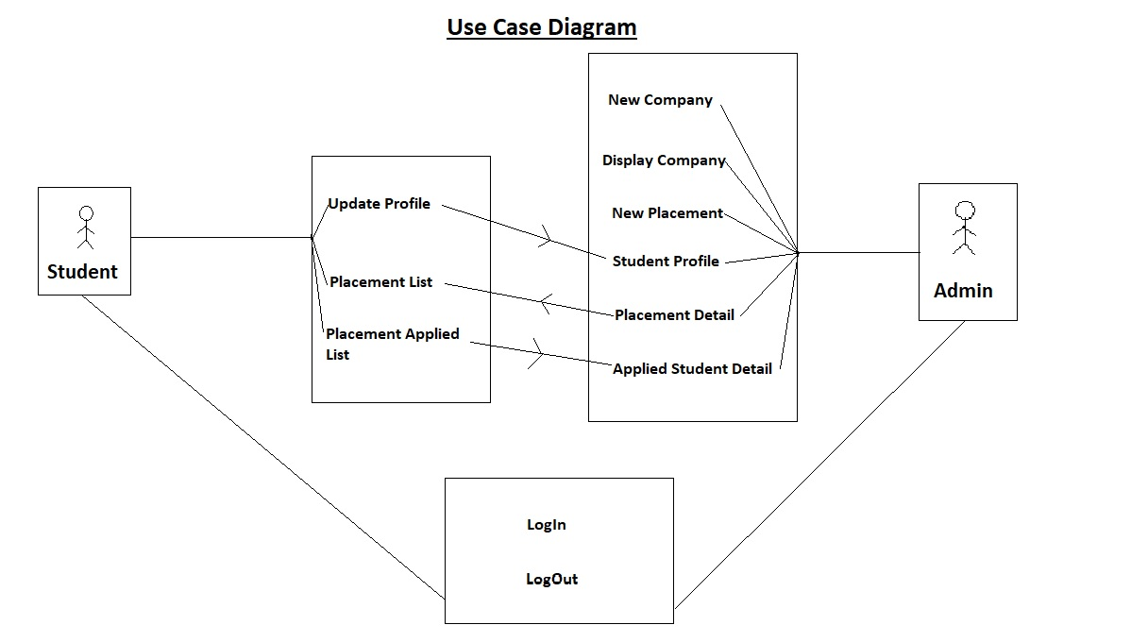
USE CASE DIAGRAM

Slide 17
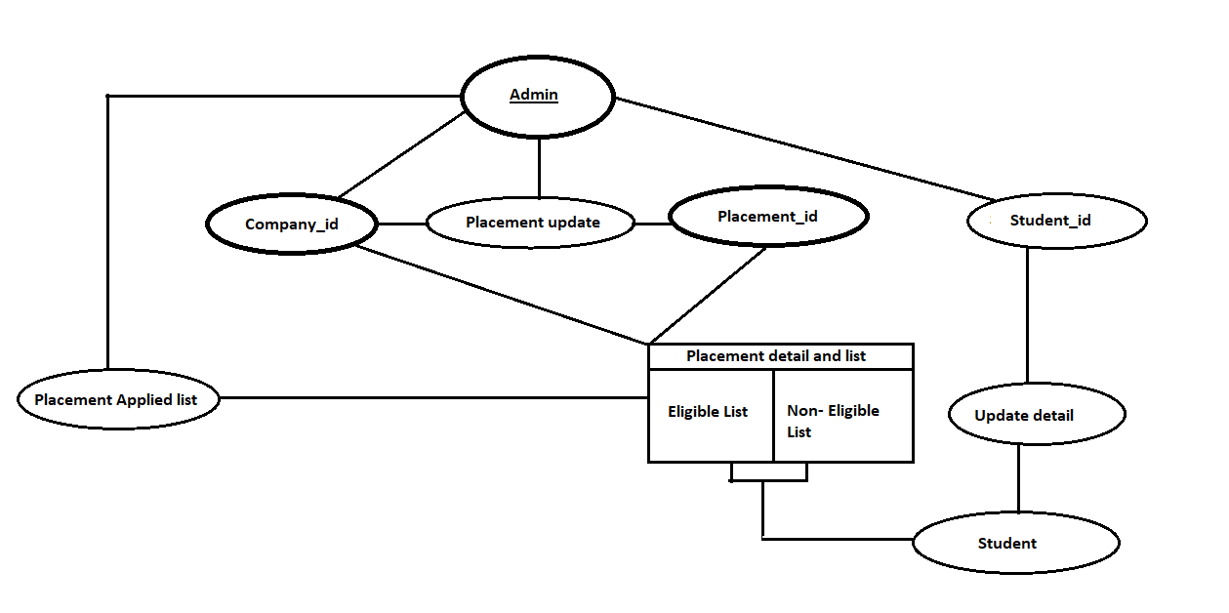
CLASS DIAGRAM

Slide 18
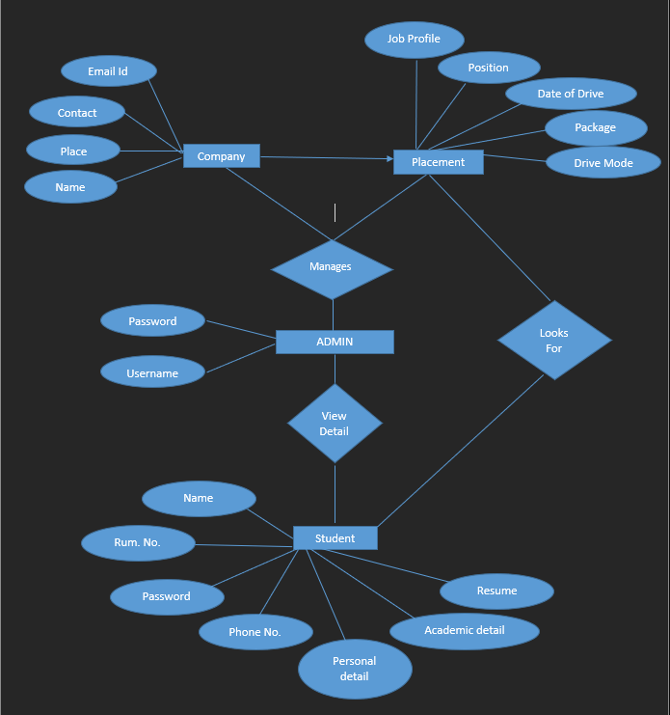
E-R DIAGRAM

Slide 19
EXPECTED OUTCOMEs
The implementation of a placement management system in a campus can have several expected outcomes that benefit both students and the institution. This system streamlines the entire placement process, making it more efficient and organized. It enables students to easily access and apply for job opportunities, submit their resumes, and track the progress of their applications. This simplification saves time and effort for both students and administrators, allowing them to focus on other important tasks.

Slide 20
THANK YOU

